Slide 1
HINY
Opensource Professional Project (Prof.Kyung soon, Hwang)
Help Is always Near You
Team Lazy Cheetah

Slide 2




Team Lazy Cheetah
Minwoo, Cho
Jaehong, Nam
Seokhyeon, Yun
Junhyeon, Sim
Team Leader
Project Manager
Algorithm Designer
Fullstack Developer
Team Member Data Analyst
Back-end Developer
Team Member API Designer
Back-end Developer
Team Member App Designer
Front-end Developer

Slide 3
TABLE OF CONTENTS
01.
02.
03.
04.
Project Subject
Project Target
What is project HINY?
Who needs this project?
Deferentiate
System Introduction
Differentiate from other application
Introduction to project HINY

Slide 4
Project Subject
Project HINY is an Android application that analyzes the medicines needed in case of emergency and recommends medicines stores.

Slide 5
Project Target
· Nighttime emergency patients
· Patients who can't get to the hospital
· Patients in rural areas with no pharmacy nearby
· People who want to travel

Slide 6
Deferentitate
ConnectDI
HINY
Medicines Full Management Web Site
Low accessibility to the public
Can't access emergency medicine in smartphone
Only Management Emergency Medicine
High accessibility to the public
Works in smartphone

Slide 7
System Introduction
THIS IS HOW OUR PROJECT WORKS

Slide 8
THEM
Mercury is the closest planet to the Sun
US
Venus has a beautiful name, but it’s hot

Slide 9
SOLUTION
Despite being red, Mars is actually a cold place. It’s full of iron oxide dust, which gives the planet its reddish cast

Slide 10
PROBLEM
SOLUTION
Saturn is the ringed one. It is a gas giant
Mercury was named after a Roman god

Slide 11
SWOT ANALYSIS
S
W
O
T
STRENGTHS
WEAKNESSES
Despite being red, Mars is actually a cold place
Saturn is a gas giant and has several rings
OPPORTUNITIES
THREATS
Jupiter is the biggest planet of them all
Venus is the second planet from the Sun

Slide 12
SWOT ANALYSIS
STRENGTHS
W
OPPORTUNITIES
T
Mars is actually a cold place
Jupiter is the biggest one
S
WEAKNESSES
O
THREATS
Saturn is a gas giant too
Venus has a nice name indeed

Slide 13
PRODUCT OVERVIEW
VENUS
SATURN
It has a beautiful name, but also high temperatures
Saturn is composed of hydrogen and also helium

Slide 14
PRODUCT DEVELOPMENT
23M
12M
950K
STEP 1
STEP 2
STEP 3
Venus has a nice name
Mars is a very cold place
Jupiter is the biggest planet

Slide 15
OUR PLANS
PRO
PREMIUM
Service
Service
Service
Service
Service
Service
Service
Service
Service
Service
BASIC
Service
Service

Slide 16
OUR PLANS
Jupiter is the biggest one
Mars is a cold place
Neptune is the farthest
Mercury is the smallest one
Uranus is the coldest planet
Venus has a beautiful name

Slide 17
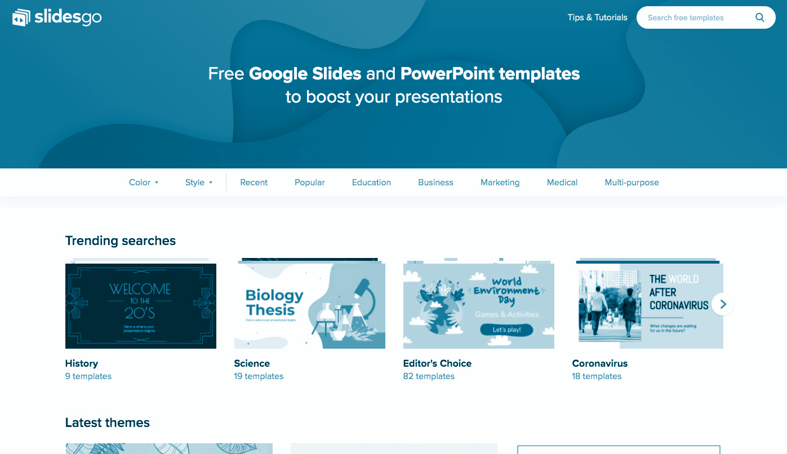
PRODUCT DEMO
You can replace the image on the screen with your own work. Right-click on it and then choose “Replace image” so you can add yours

Slide 18
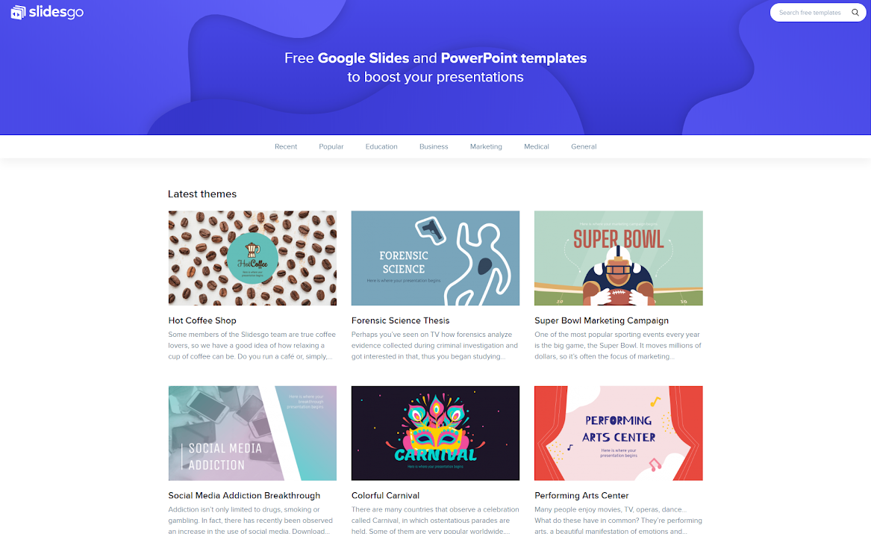

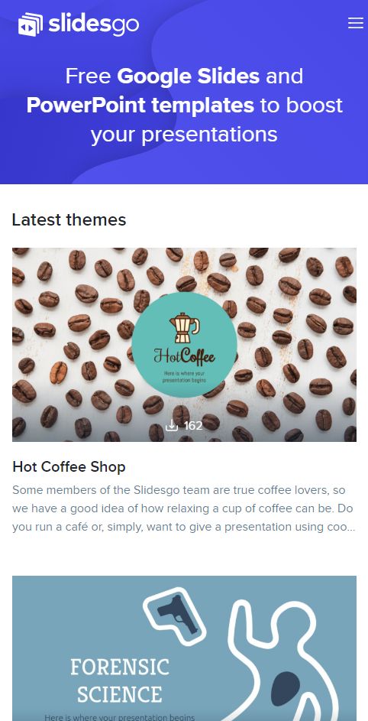
PRODUCT DEMO
STEP 1
STEP 2
STEP 3
Venus has a nice name
Mars is a very cold place
Jupiter is the biggest one

Slide 19
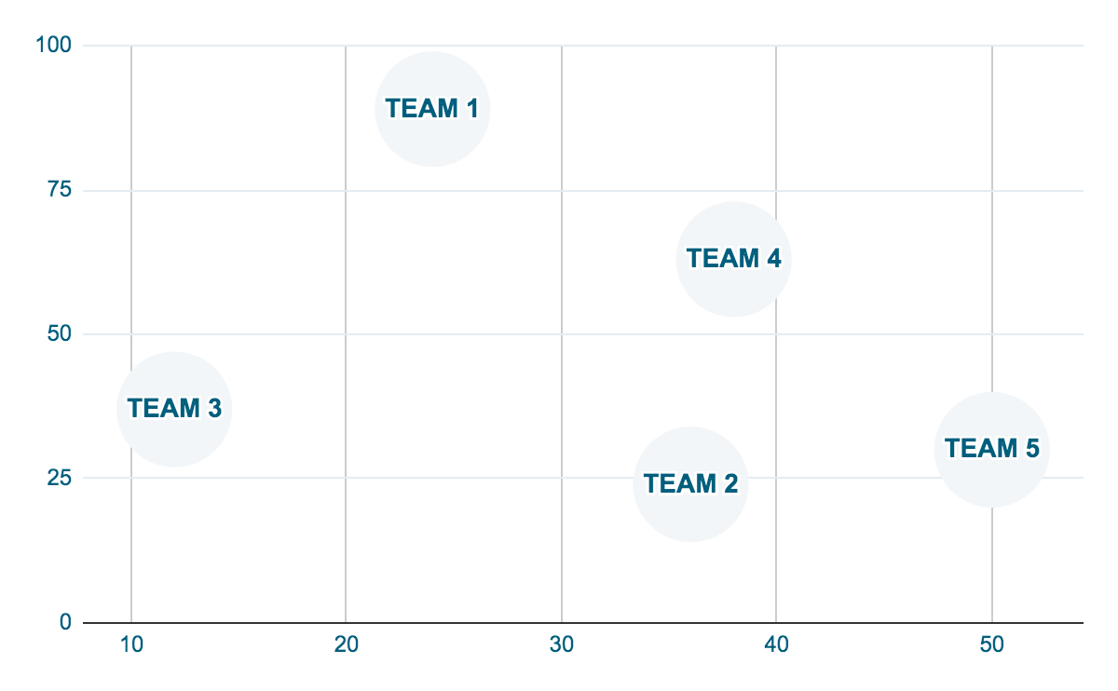
TRACTION
50,000
PRO USERS
390,000
QUERIES
250,000
MOBILES
To modify this graph, click on it, follow the link, change the data and paste the new graph here

Slide 20
BUDGET
874,000
700,000
SATURN
MARS
580,600
VENUS
Saturn is a ringed gas giant
Despite being red, Mars is cold
Venus has a nice name, but it’s hot

Slide 21

A PICTURE IS WORTH A THOUSAND WORDS

